Slide 1
Admissions Dashboard
A Guide to Understanding and Using the Dashboard Effectively
Dashboard Location
https://analytics.bsu.edu/#/projects/39
Data Cookbook Link
https://bsu.datacookbook.com/institution/reports/54936

Slide 2
Admissions Dashboard Overview
Purpose: The Admissions dashboards are designed to provide a comprehensive overview of the admissions process, focusing on key areas such as applicant demographics, academic preparedness, geographical distribution, and overall admission trends.
Dashboards include:
Comparison of applied, admitted, and enrolled counts across terms.
Breakdown by College, Student Level, Sex, Online/International Status, and IPEDS Ethnicity.
Geographic distributions of applicants (county, state, international).
Trends in academic preparedness (ACT/SAT scores).
Funnel visualizations and yield/admit rate analysis.

Slide 3
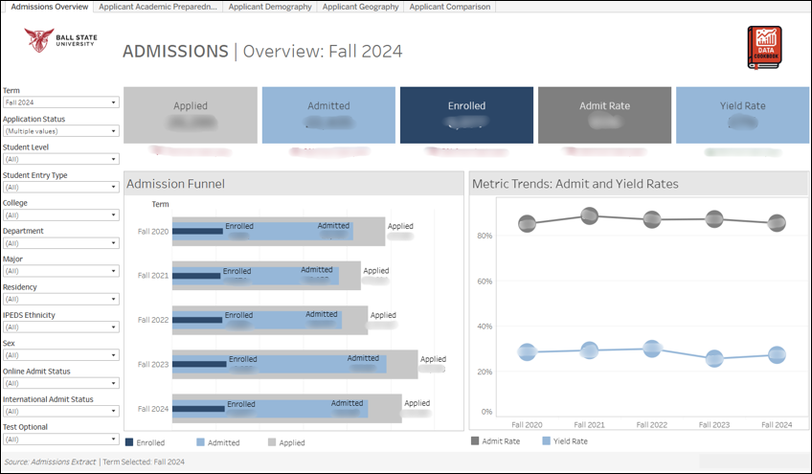
Admissions Overview Dashboard
Data note: You may see in this dashboard incomplete terms that are in progress.
These are called cards in Tableau and provide a fast high-level overview of data for the selected term.
Click on the Data Cookbook at the top left corner to start with and learn more about this dashboard and the fields in this dashboard.
Click these dropdowns to apply your desired term, major, residency, and other desired filter.
The bar chart shows applicant progression term-wise through the admissions funnel: Applied, Admitted, and Enrolled.
The line chart visualizes Admit and Yield Rate trends across multiple years.
1
2
3
4

Slide 4
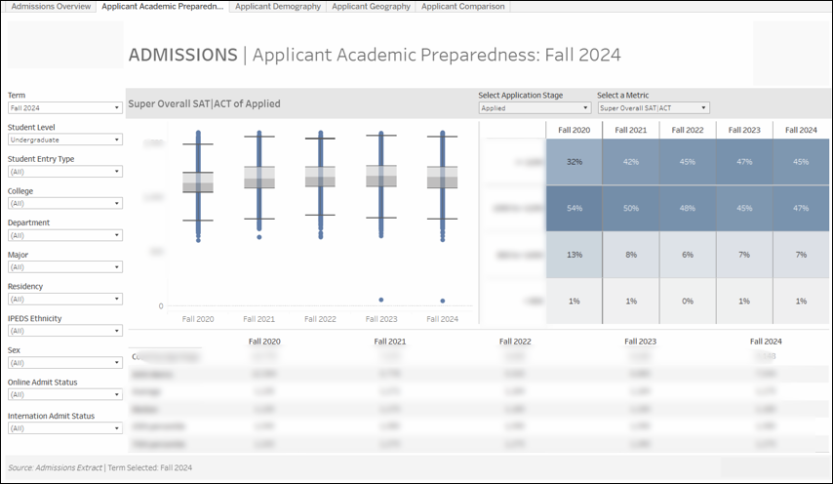
Admissions Applicant Academic Preparedness
“Heatmap” grid that shows how many applicants fall into different score ranges across terms. Darker colors mean higher percentages.
Box and whisker chart that shows how scores are spread out, where most applicants fall, the middle range, and any unusually high or low scores (outliers).
Click these dropdowns to select term, major, department and other filters.
The boxplot shows the distribution of selected metric across application terms, highlighting spread and outliers.
The heatmap on the right breaks scores into percentile bands to compare how academic readiness shifts year to year.
The summary table includes key statistics such as count, average, median, and percentiles for each term.
2
3
1
Quick view of key stats, number of applicants, average scores, and percentiles (like median or 75th percentile).
4

Slide 5
Admissions Applicant Academic Preparedness (extended)
Click the dropdown to select term, major, department and other filters.
Use this dropdown to toggle between Applied, Admitted, or Enrolled stages.
Use this dropdown to toggle between Super ACT, Super SAT, Super Overall SAT|ACT, HS GPA, or Prior Institution GPA.
The data will update (boxplot, heatmap, table) to reflect the selected stage of the funnel.
1
2
3
4
4

Slide 6
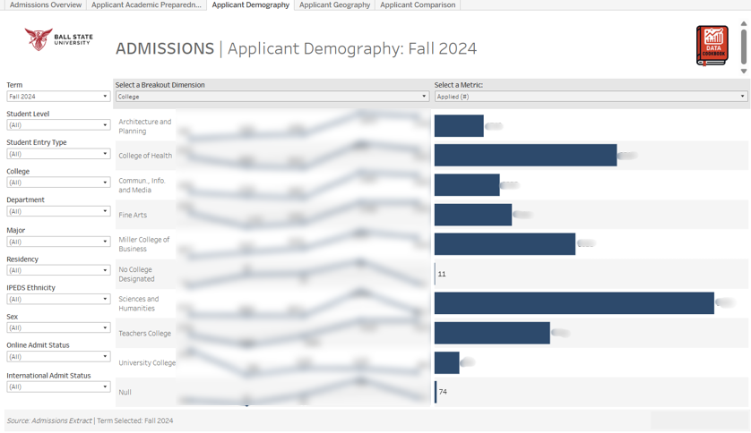
Applicant Demography
Select term, major, department and other filter.
Select a breakdown dimension College, Student Level, Sex, Online Admit Status, International Admit Status, IPEDS Ethnicity.
Select a metric: Applied, Admitted, Enrolled, Admit Rate, Yield Rate to analyze trends and compare groups.
1
2
3
Line charts display multi-year trends for the selected metric (e.g., Applied, Admitted, Enrolled, Admit Rate %, Yield Rate %) by the chosen grouping.
Changing the selection dynamically updates both the multi-year trend lines (left side) and the selected term’s summary bar chart.

Slide 7
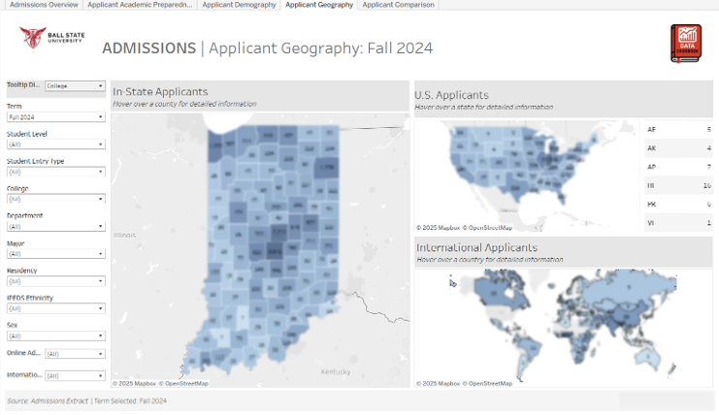
Applicant Geography
Shows where applicants come from across the U.S. Each state’s shading reflects the number of applicants, darker means more.
Select college
Select term, major, department and other filters. This dashboard provides a visual overview of where applicants are coming from locally, nationally, and internationally
Indiana county-level map shows applicant counts by county.
U.S. Applicants displays number of applicants from each U.S. state.
International Applicants visualizes global applicant origins by country.
4
1
3
2
Shows applicant counts by county. Darker shades mean more applicants from that area. Hover to see exact numbers.
5
Displays global origins of applicants. Countries are shaded based on how many applicants applied from each.

Slide 8
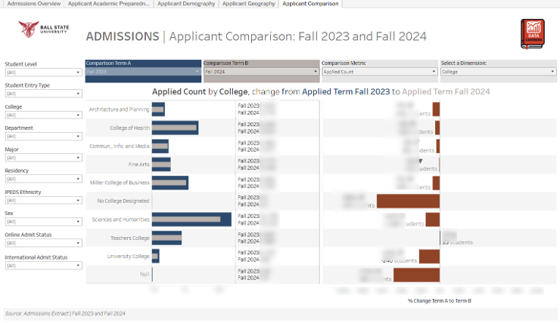
Applicant Comparison
Select term, major, department and other filters.
Select the Comparison Terms (A & B).
Select the comparison metric: Toggle between Applied Count, Admitted Count, Enrolled Count.
Select dimension, this parameter allows users to customize the grouping of comparison data based on specific student characteristics. Toggle between College, Student Level, Sex, Online Admit Status, International Admit Status, IPEDS Ethnicity.
The bar on the right displays the percentage and numeric change between the two terms, making it easy to identify gains or losses.
1
2
2
3
4
5

Slide 9


Documentation & Resources
Tableau Dashboard
View admissions data visualizations.
Data Cookbook Specification
Review data definitions, and source documentation supporting this dashboard.

