Slide 1
Admissions Dashboard
A Guide to Understanding and Using the Dashboard Effectively

Slide 2
Admissions Dashboard Overview
Purpose: The Admissions dashboards are designed to provide a comprehensive overview of the admissions process, focusing on key areas such as applicant demographics, academic preparedness, geographical distribution, and overall admission trends.
Dashboards include:
  Comparison of applied, admitted, and enrolled counts across terms.
  Breakdown by College, Student Level, Sex, Online/International Status, and IPEDS Ethnicity.
  Geographic distributions of applicants (county, state, international).
  Trends in academic preparedness (ACT/SAT scores).
  Funnel visualizations and yield/admit rate analysis.

Slide 3
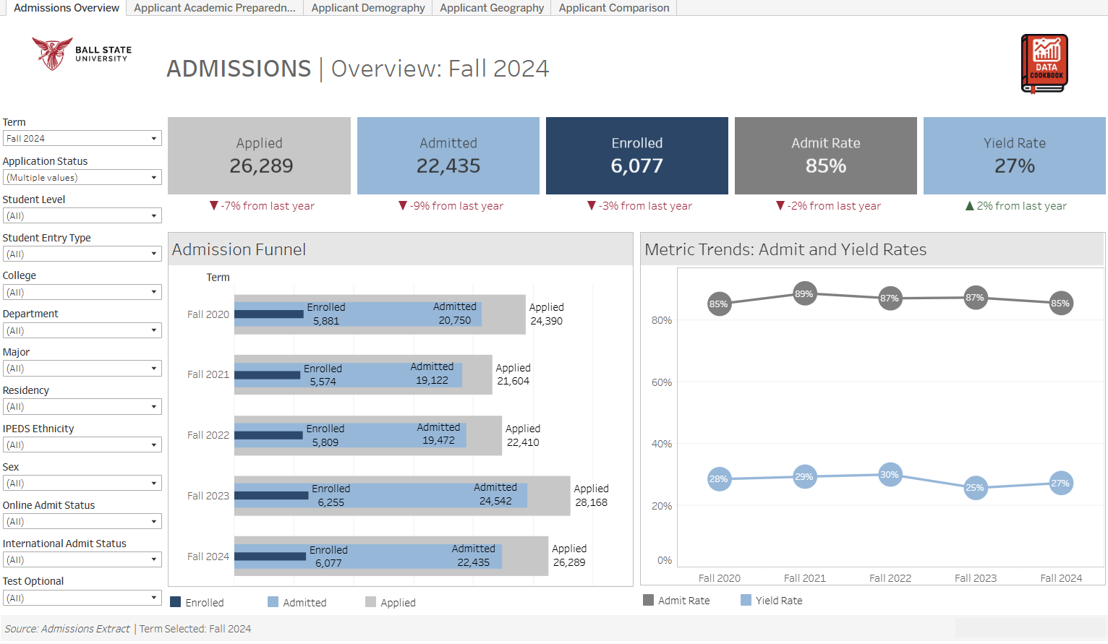
Admissions Overview Dashboard
Displays overall counts for Applied, Admitted, and Enrolled students using KPI tiles, with year-over-year percentage changes.
Bar chart shows term-wise applicant progression across stages: Applied, Admitted, and Enrolled.
Line chart visualizes Admit and Yield Rate trends across multiple years.

Slide 4
Dashboard Filters
Use filters to narrow data by Term, Application Status, Student Level, Entry Type, College, Department, Major, Residency, IPEDS Ethnicity, Sex, Online Admit Status, International Admit Status, Test Optional.
Combining filters provides more targeted insights.
Helps customize the view to specific programs or demographics.

Slide 5
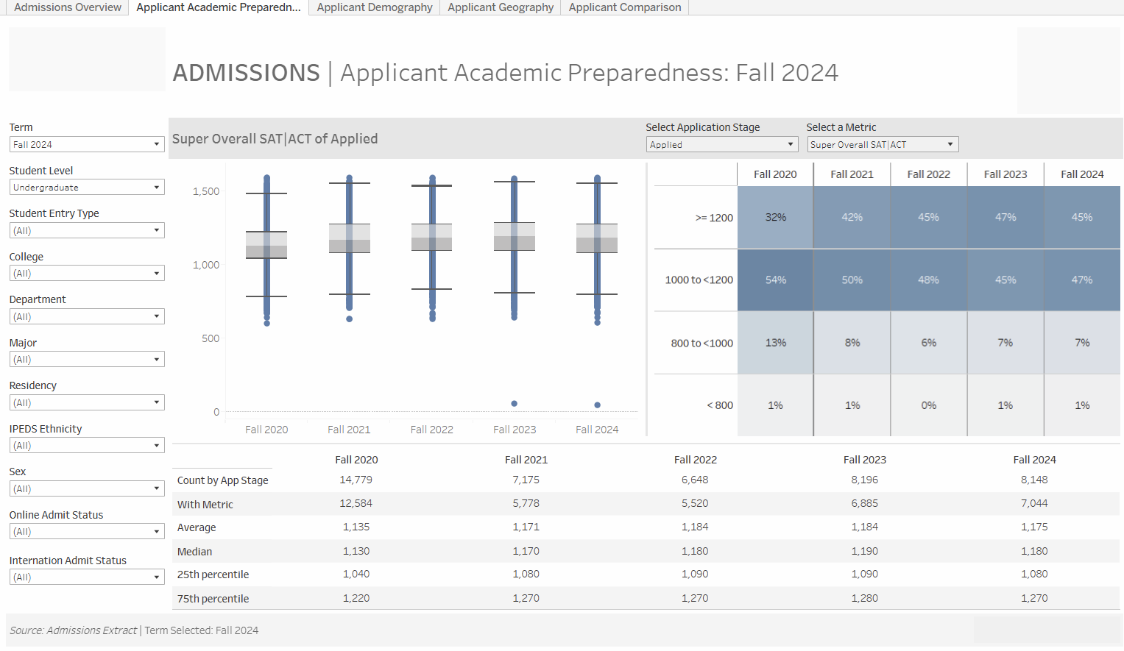
Admissions Applicant Academic Preparedness
Boxplot on the left shows the distribution of selected metric across application terms, highlighting spread and outliers.
Heatmap on the right breaks scores into percentile bands to compare how academic readiness shifts year to year.
Summary table below includes key statistics such as count, average, median, and percentiles for each term.

Slide 6
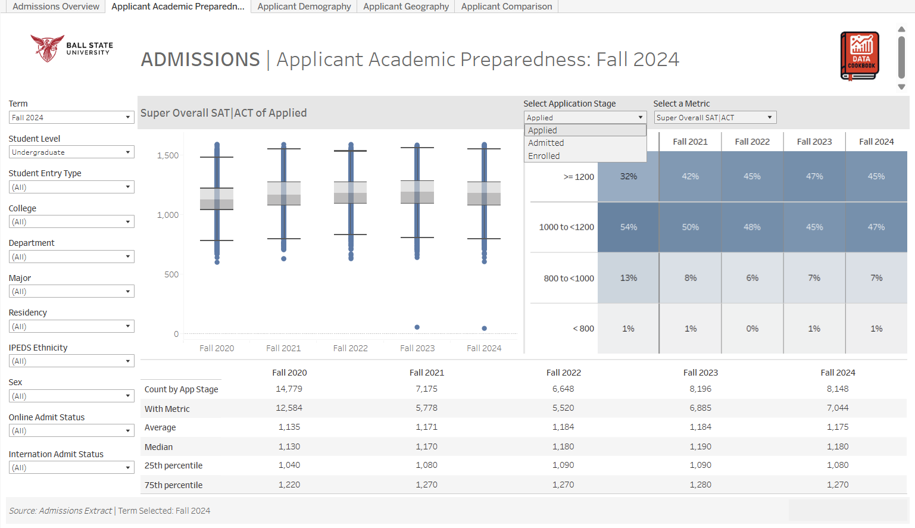
Admissions Applicant Academic Preparedness
The ‘Select Application Stage’ parameter enables users to analyze test score distributions across different stages in the admissions funnel.
Use this dropdown to toggle between Applied, Admitted, or Enrolled stages.
Updates all visuals (boxplot, heatmap, table) to reflect the selected stage of the funnel.

Slide 7
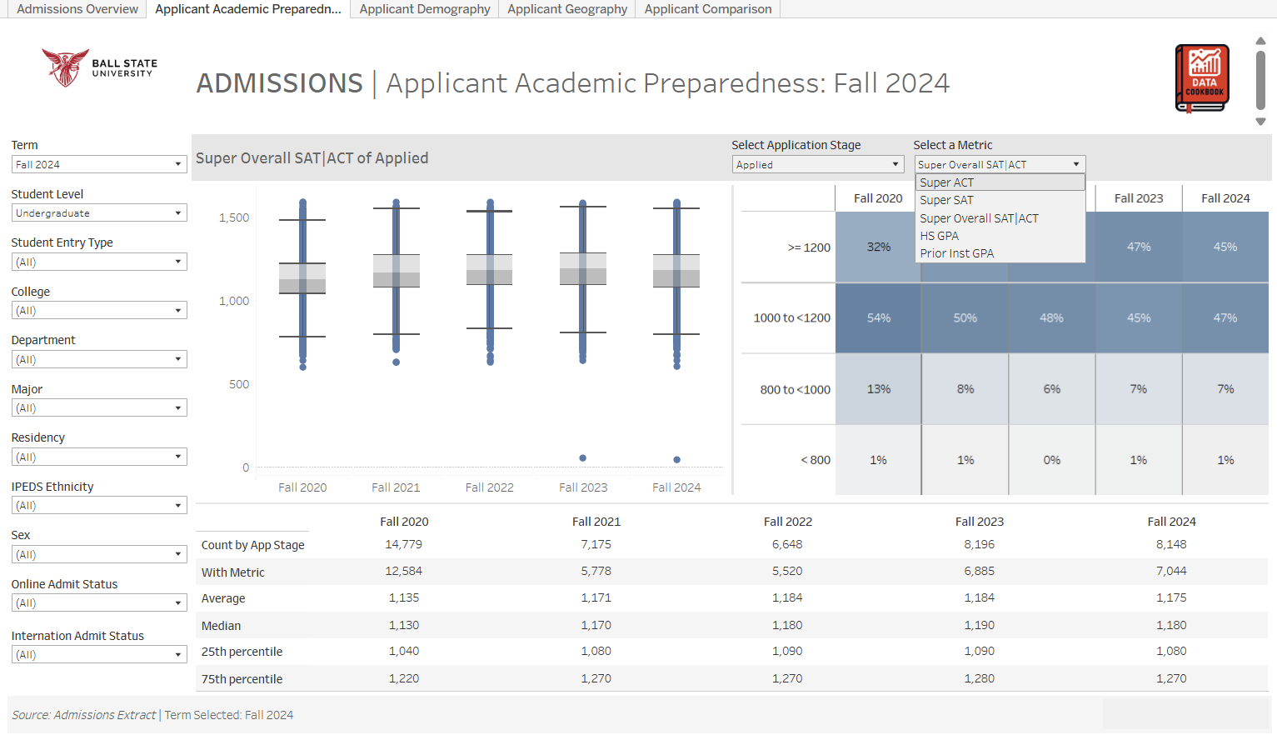
Admissions Applicant Academic Preparedness
The ‘Select a Metric’ parameter enables users to evaluate academic preparedness based on different standardized or institutional academic measures.
Use this dropdown to toggle between Super ACT, Super SAT, Super Overall SAT|ACT, HS GPA, or Prior Institution GPA.
Updates all visuals (boxplot, heatmap, and summary table) to reflect the selected academic metric.

Slide 8
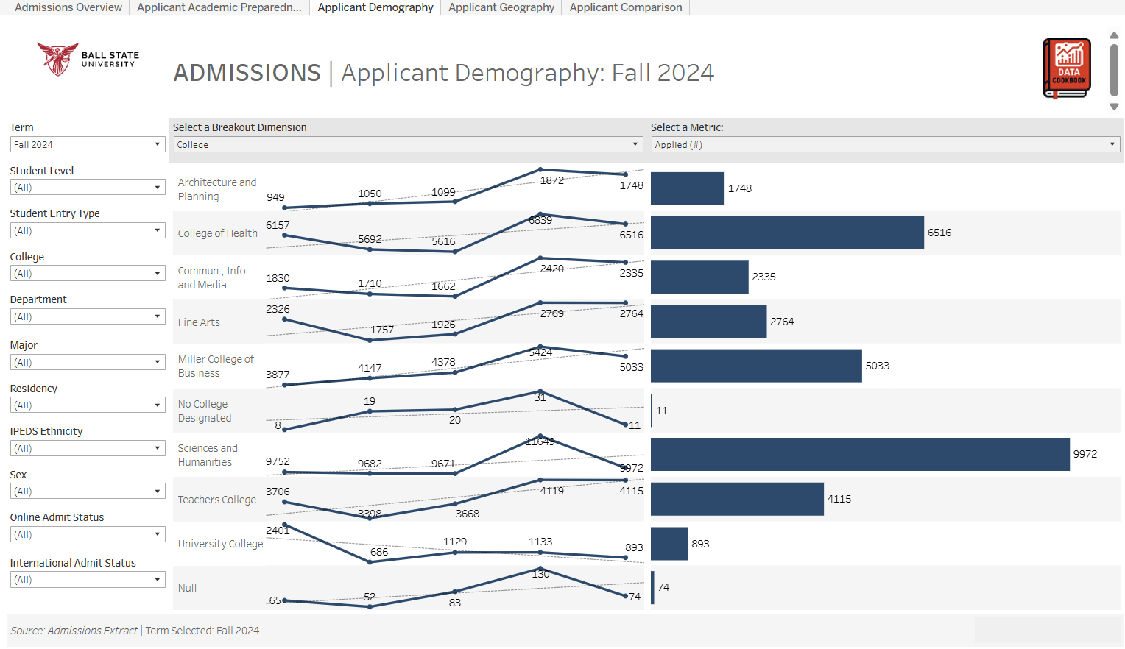
Applicant Demography
This helps assess how performance has changed over time by academic or demographic group.
Line charts display multi-year trends for the selected metric (e.g., Applied, Admitted, Enrolled, Admit Rate %, Yield Rate %) by the chosen grouping.
Bar charts on the right summarize the most recent term’s values for comparison across categories.

Slide 9

Applicant Demography
This parameter enables users to control how the trend data is grouped and visualized.
Allows users to toggle between College, Student Level, Sex, Online Admit Status, International Admit Status, IPEDS Ethnicity
Changing the selection dynamically updates both the multi-year trend lines (left side) and the selected term’s summary bar chart (right side).

Slide 10
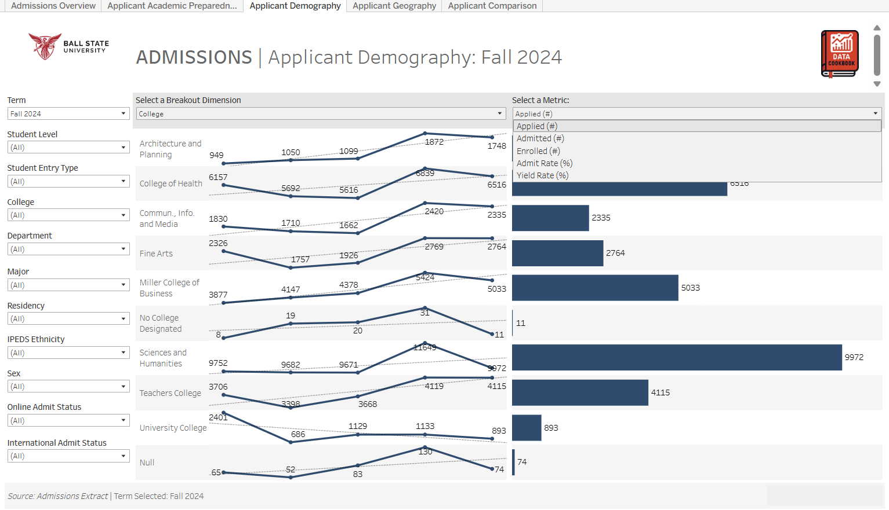
Applicant Demography
This parameter allows users to switch between different admissions-related measures like Applied, Admitted, Enrolled, Admit Rate, Yield Rate to analyze trends and compare groups.
Changing the selection dynamically updates both the multi-year trend lines (left side) and the selected term’s summary bar chart (right side).

Slide 11
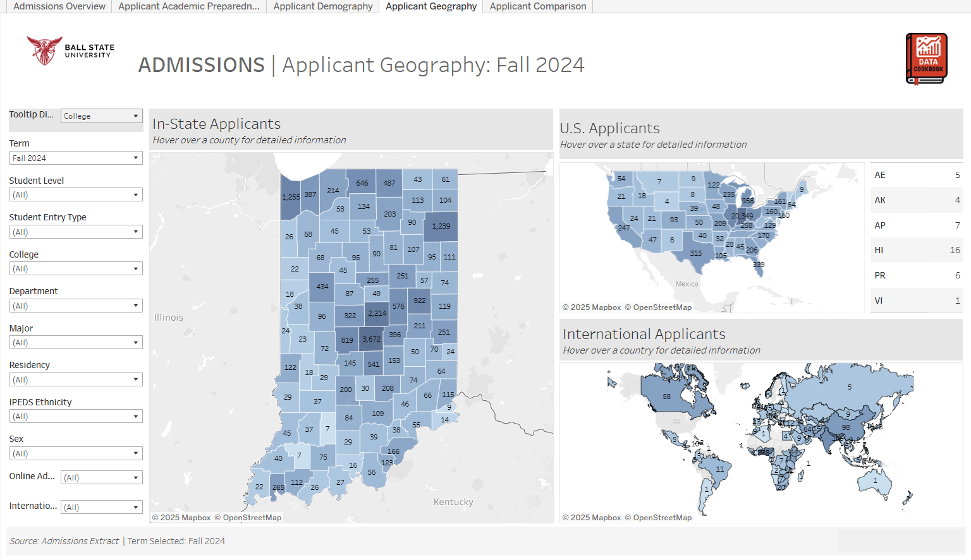
Applicant Geography
This dashboard provides a visual overview of where applicants are coming from locally, nationally, and internationally
Indiana county-level map shows applicant counts by county.
U.S. Applicants displays number of applicants from each U.S. state.
International Applicants visualizes global applicant origins by country.

Slide 12
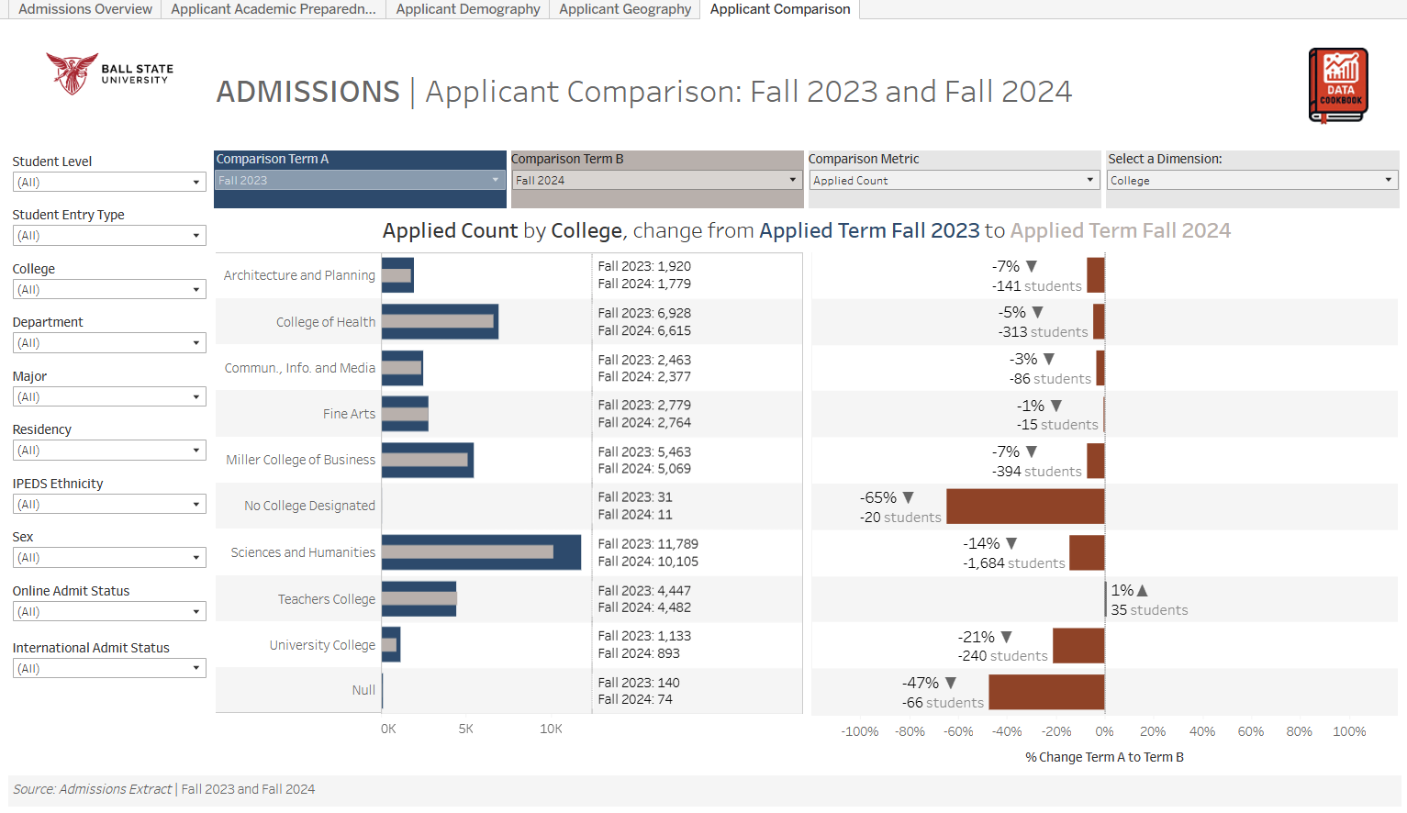
Applicant Comparison
This dashboard allows users to compare application, admission, and enrollment activity across two selected terms, broken down by student dimension.
Dual horizontal bar charts show counts from two selected terms for selected dimension.
The bar on the right displays the percentage and numeric change between the two terms, making it easy to identify gains or losses.

Slide 13

Applicant Comparison
The Comparison Metric parameter allows users to switch between different stages of the admissions process for comparison.
Toggle between Applied Count, Admitted Count, Enrolled Count.
Selecting a different metric dynamically updates the bar charts and percentage change indicators across the dashboard.

Slide 14
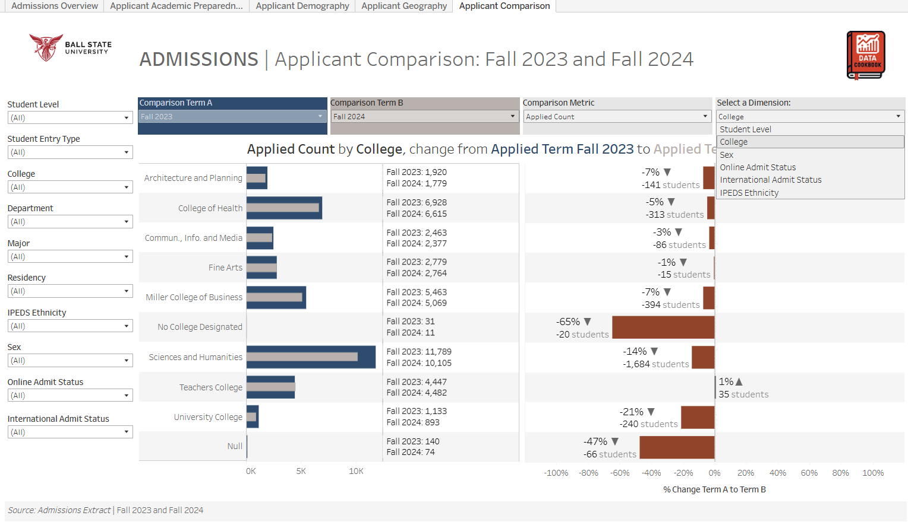
Applicant Comparison
This parameter allows users to customize the grouping of comparison data based on specific student characteristics.
Toggle between College, Student Level, Sex, Online Admit Status, International Admit Status, IPEDS Ethnicity.
Selecting a dimension updates both the comparison bars and percentage change views, letting users evaluate trends by the chosen student segment.

Slide 15


Documentation & Resources
Tableau Dashboard
  View admissions data visualizations.
Data Cookbook Specification
  Review data definitions, and source documentation supporting this dashboard.

